Slide 1
Career Crafter – The Job Portal
DONE BY-:
CHRISTINA MICHELLE RAYAN D
TRAINER: Javeed Mohammed Husnuddin

Slide 2
INTRODUCTION
CareerCrafter is a web-based job portal designed to bridge the gap between job seekers and employers.
It provides a centralized platform for job listing and application management.
OBJECTIVES
To facilitate secure registration, login, and role-based access for employers and job seekers.
To enable end-to-end job management — from posting jobs to applying and tracking application status.

Slide 3
TECHNOLOGIES USED
Frontend: Angular
Backend: Java, Spring Boot
Database: MySQL
Authentication: JWT (JSON Web Tokens)
Deployment: Docker

Slide 4
PROJECT MODULES
Employer Functionalities:
Post Job Listings: Create job posts with title, description, and qualifications.
Manage Job Listings: Edit, update, or delete job postings.
View Applications: Access and update job application.
Job Seeker Functionalities:
Create Profile: Add personal, educational, and professional details.
Apply to Jobs: Submit resume and documents.
Manage Applications: Track status of the application.

Slide 5
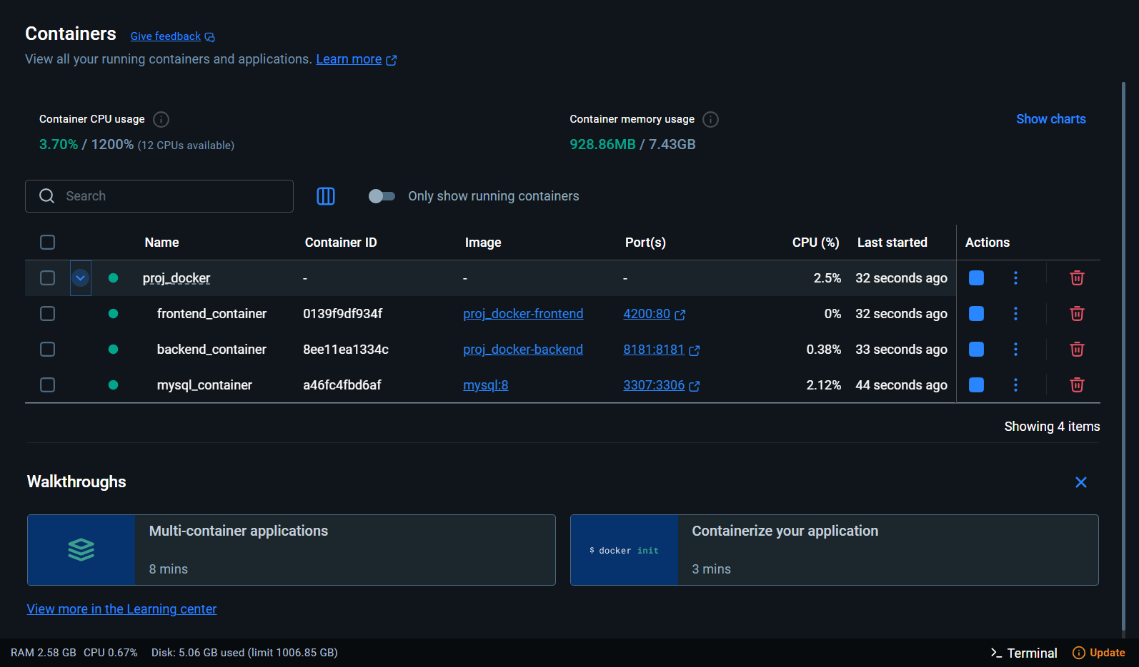
Docker Implementation:
Application is containerized for consistent environment.
Simplifies deployment & scaling.
Platform-independent execution.

Slide 6
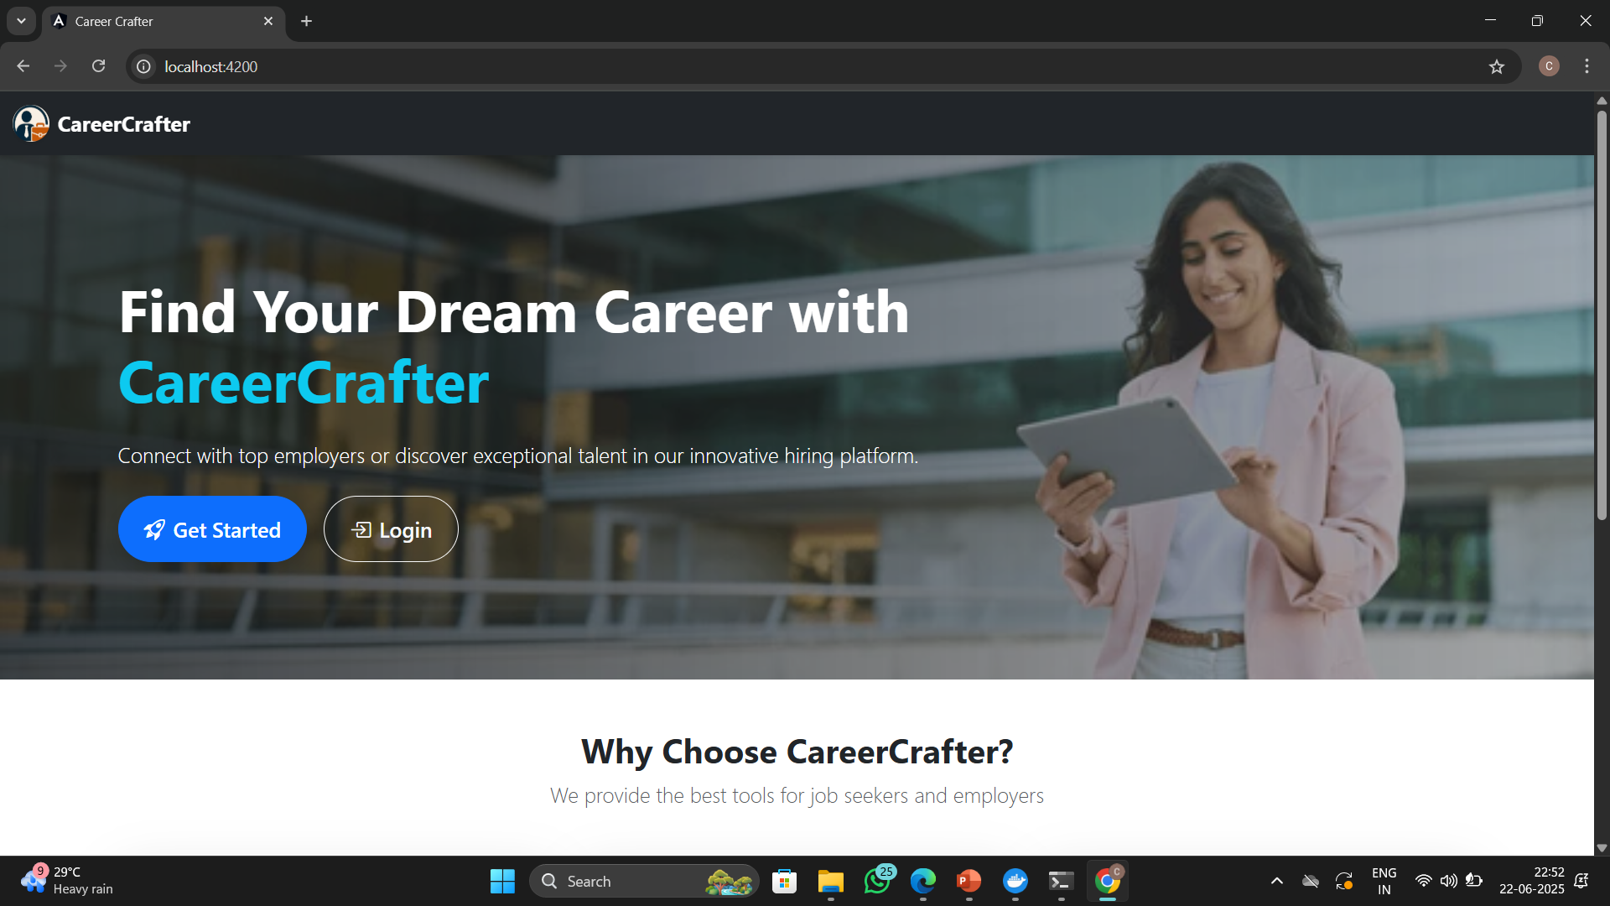
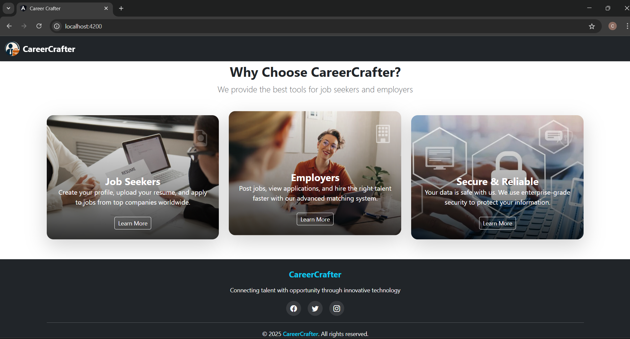
CareerCrafter Website Home Page:

Slide 7
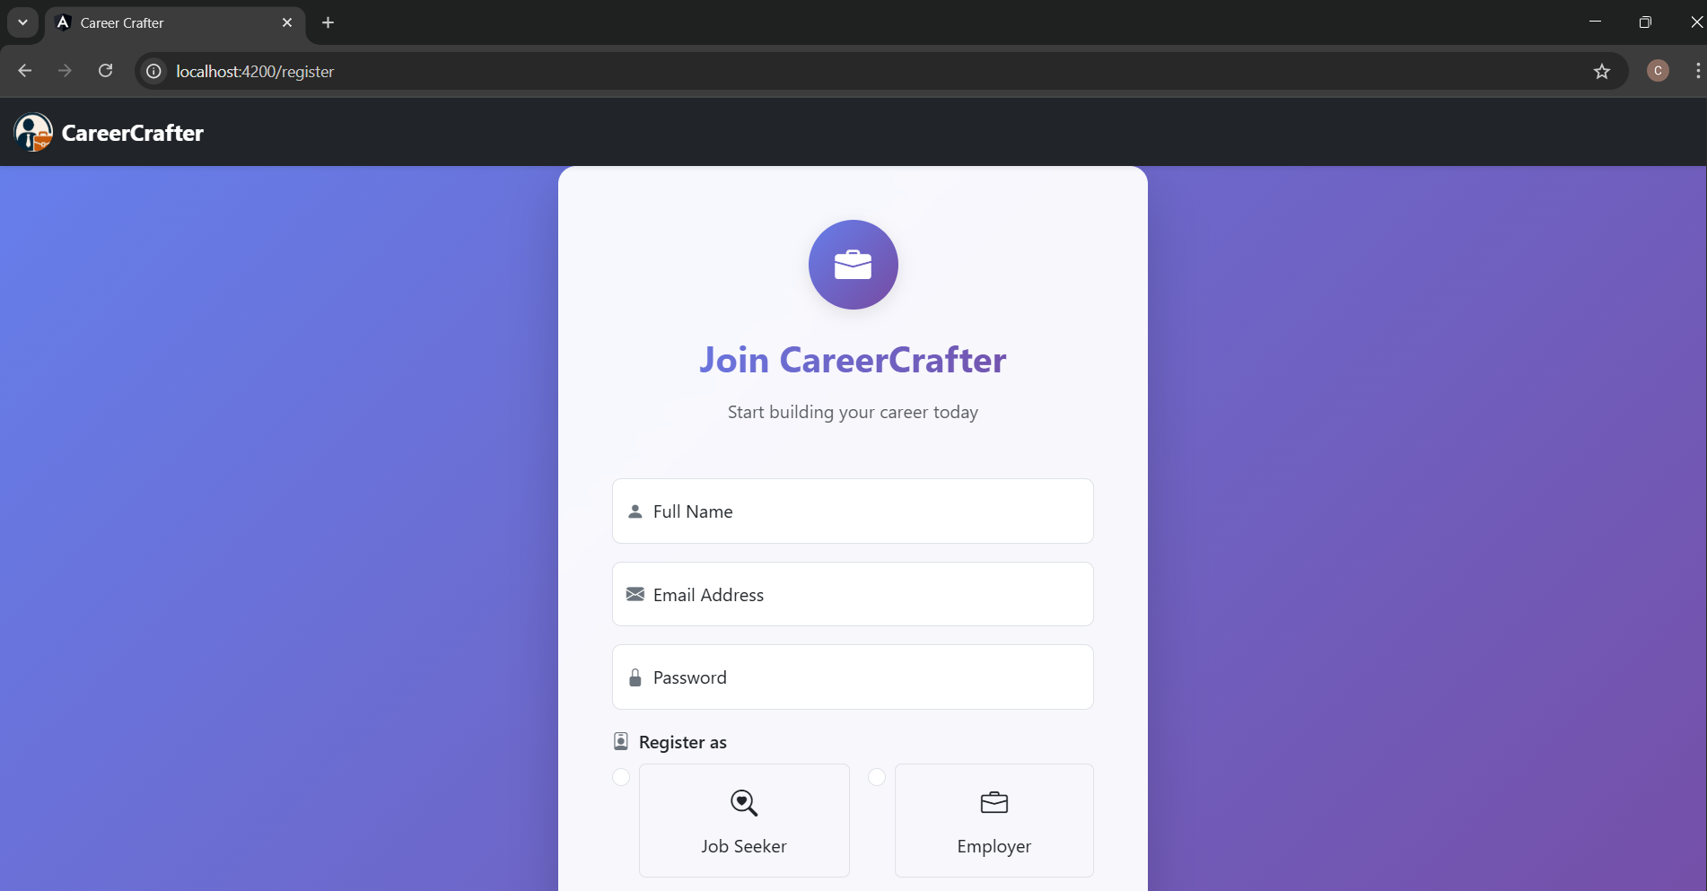

Register Page:

Slide 8
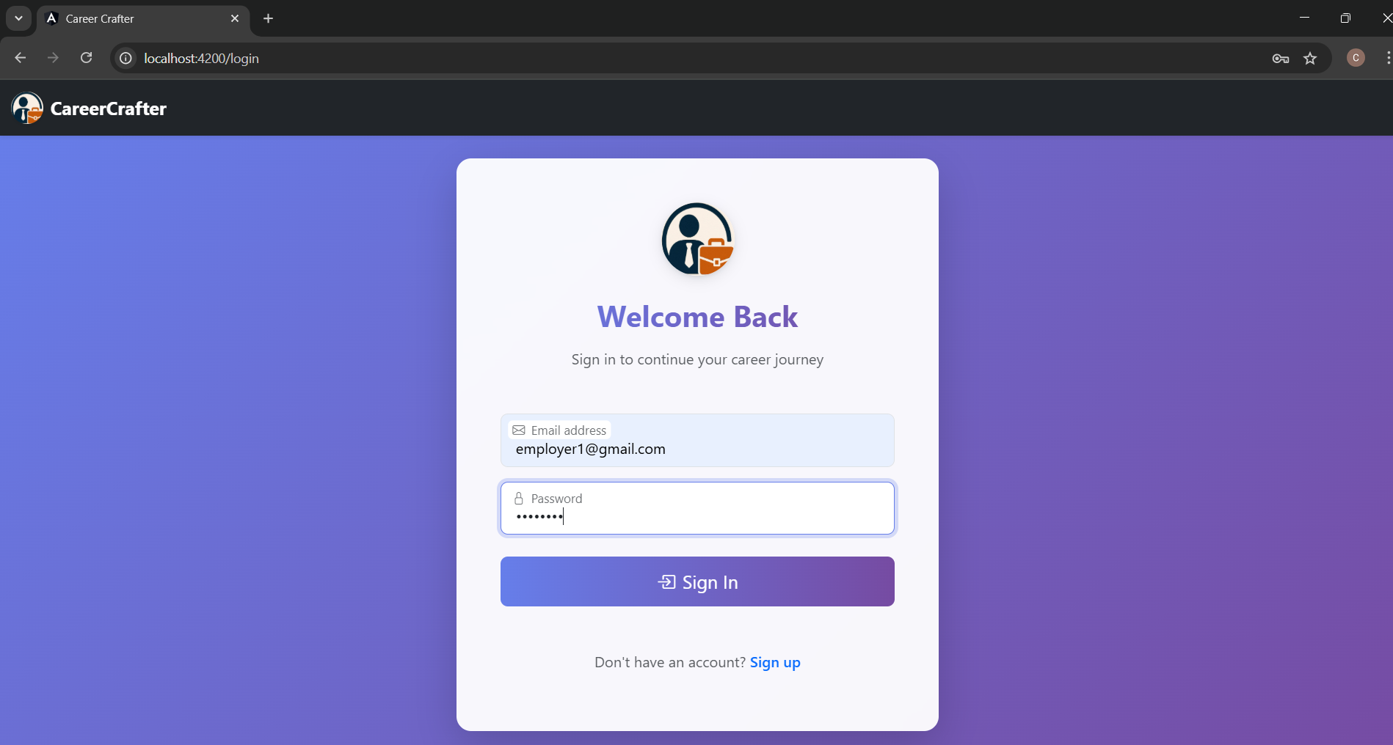
Login Page:

Slide 9
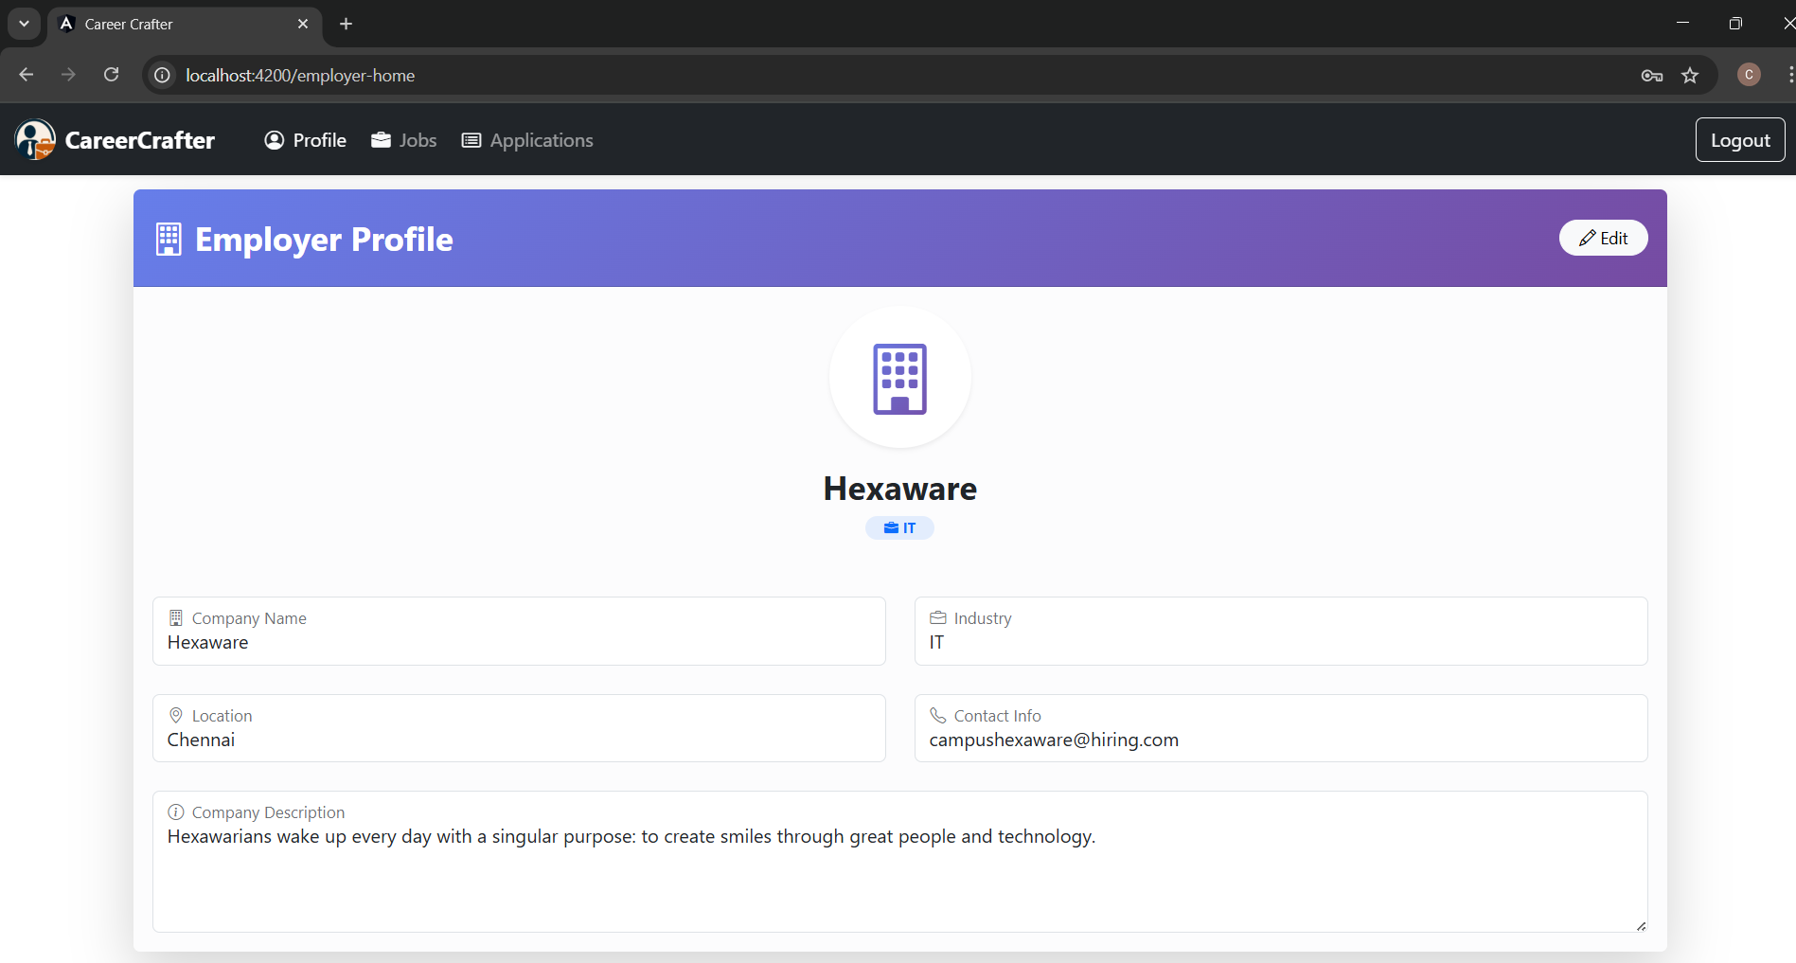
Employer Profile Page:

Slide 10
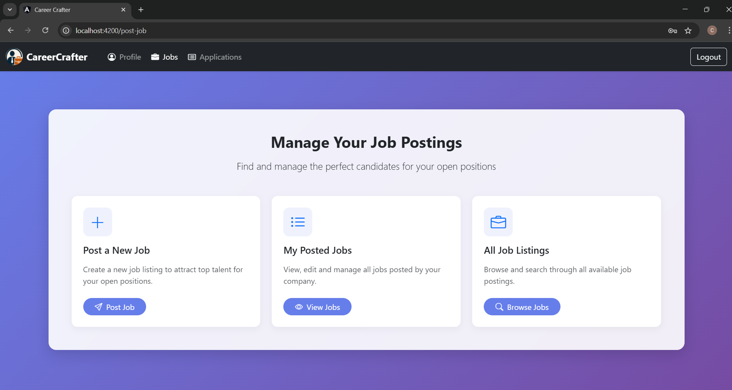
Employer Jobs Management Page:

Slide 11
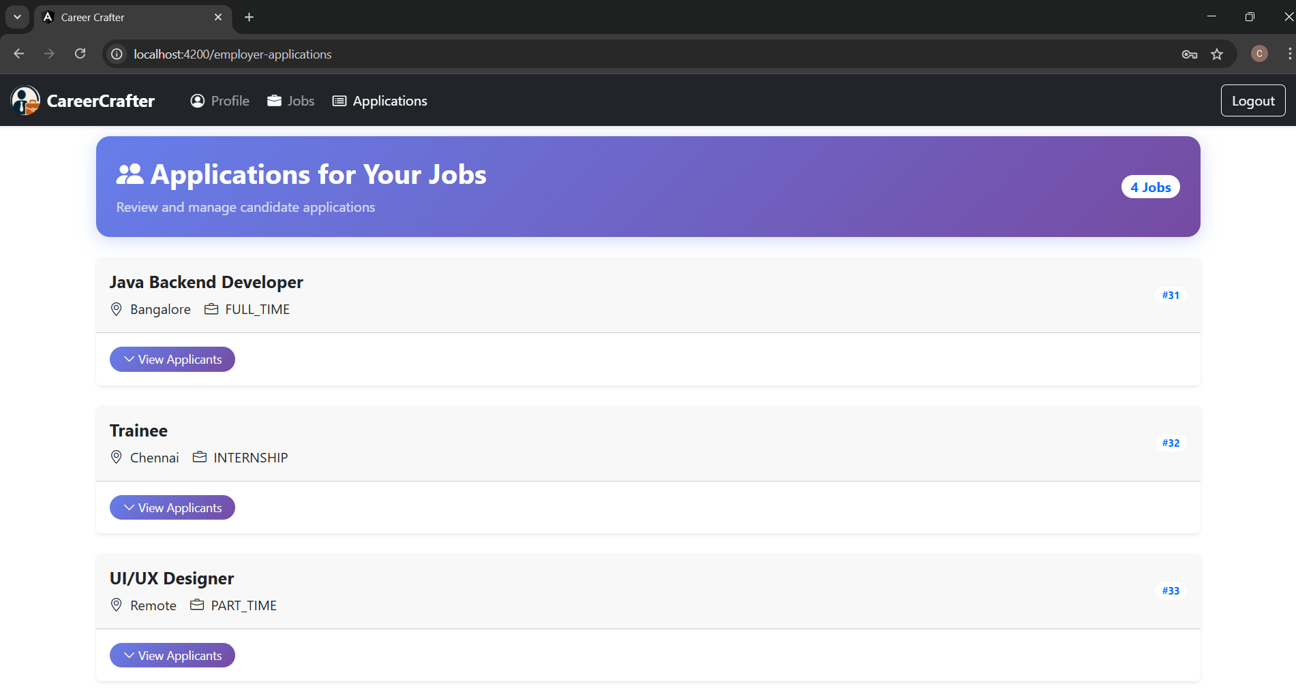
Employer Applications Management Page:

Slide 12
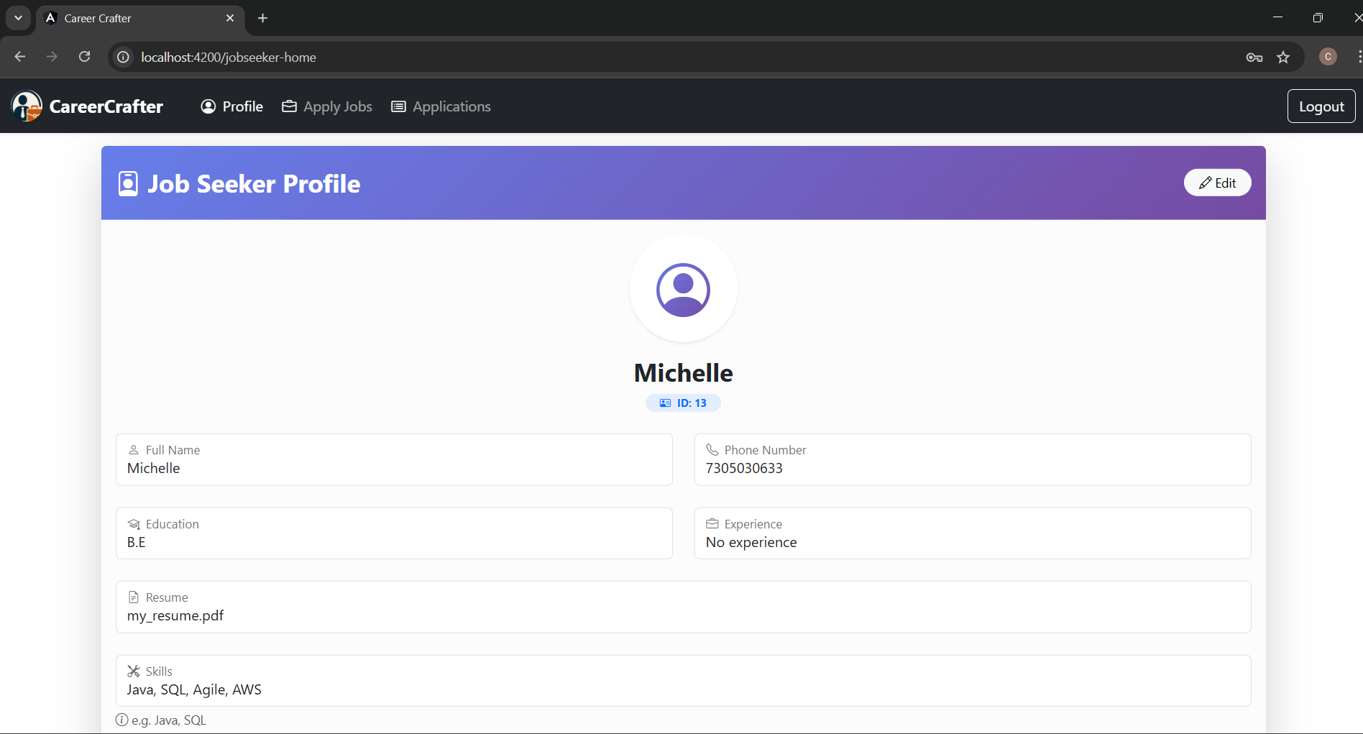
Jobseeker Profile Page:

Slide 13
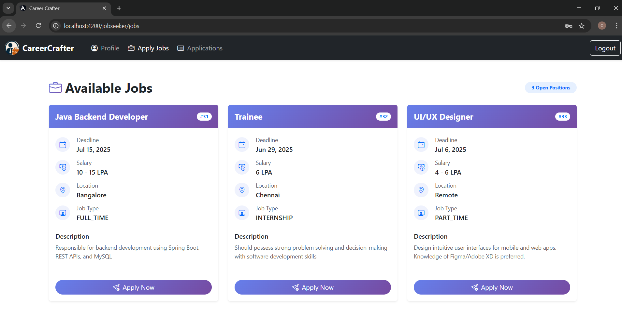
Jobseeker Jobs Page:

Slide 14
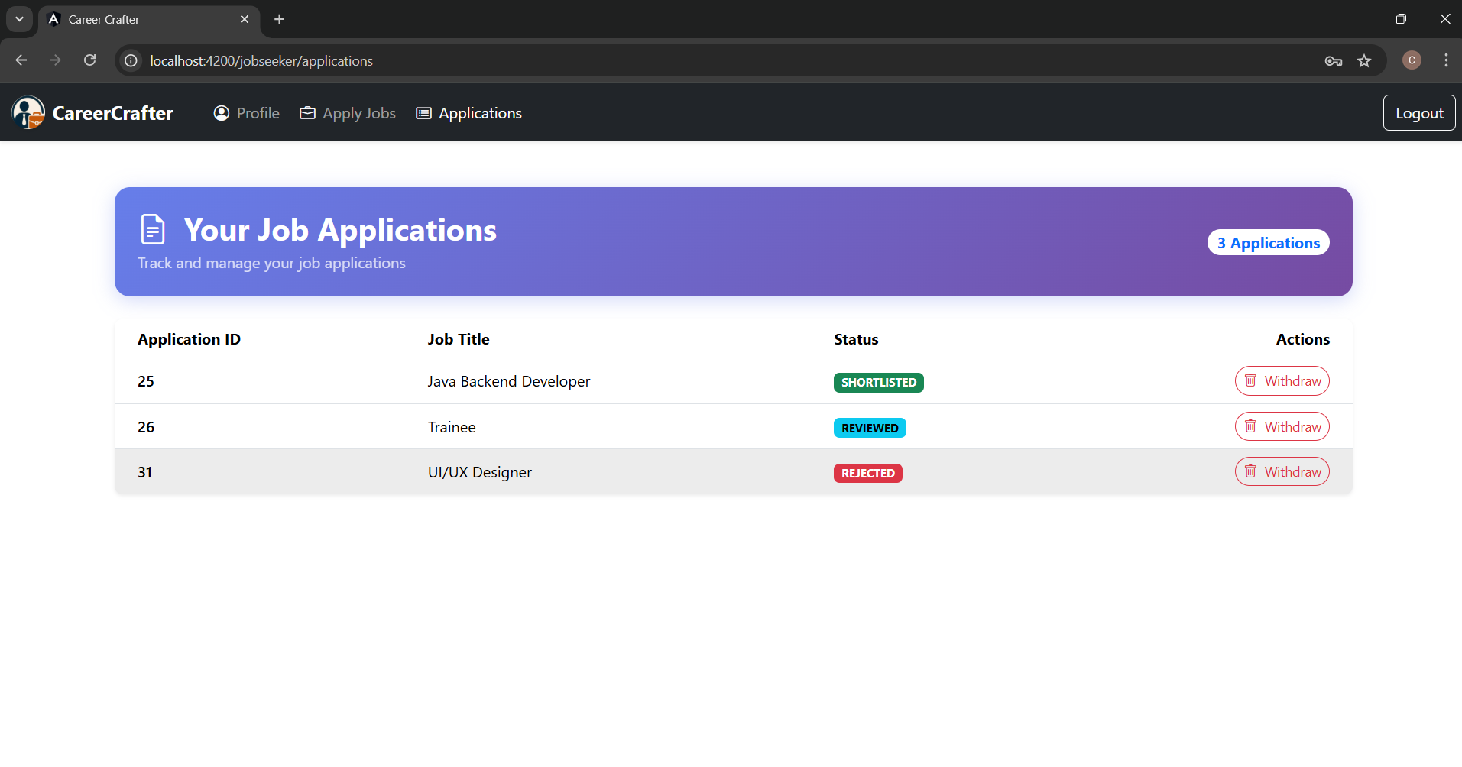
Jobseeker Application Page:

Slide 15
THANK YOU

